Slide 1
TITLE SLIDE

Slide 2
Read the passage given below and answer the following questions: SILKY Ltd. is a company which deals in hair products. It has its branches in all the parts of the world. However, the requirements of hair products are different in different parts of the world. This is due to the change in climate and lifestyles of people in the different countries. The market in which it is dealing is known for awareness of health. The more the awareness the more is the demand for such products. Company knows that the demand for these products is unpredictable as new products keep on coming and the industry keeps on changing frequently. There is a research and development department which keeps on updating the latest changes.

Slide 3
CONTENT SLIDE

Slide 4
CONTENT SLIDE

Slide 5
QUESTIONS RELATED TO ABOVE SLIDES

Slide 6
CONTENT SLIDE

Slide 7
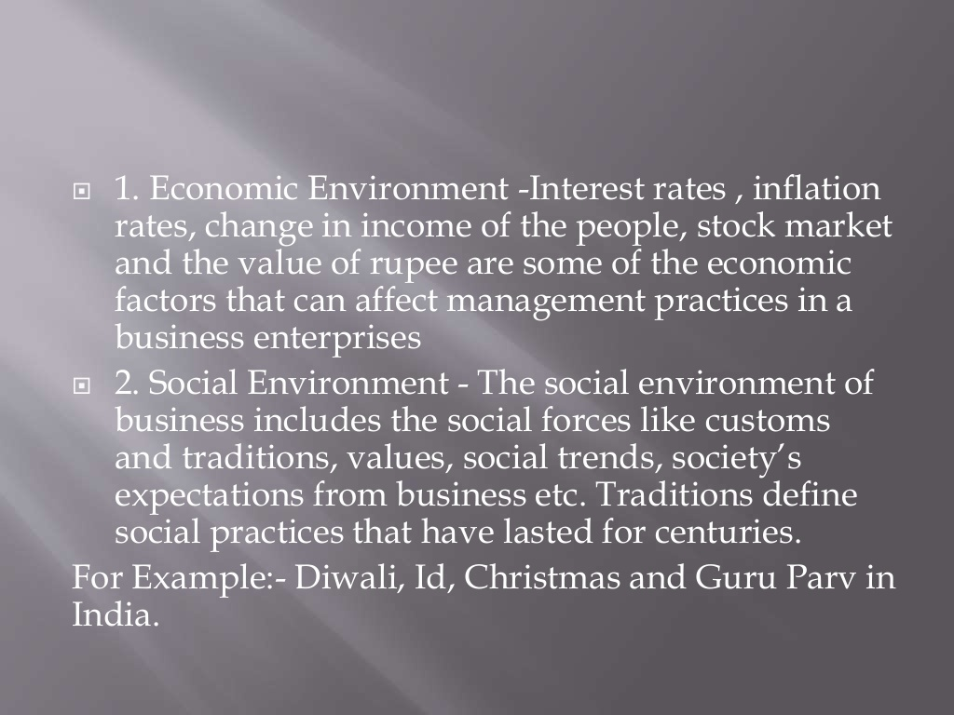
CONTENT SLIDE

Slide 8
CONTENT SLIDE

Slide 9
QUESTIONS RELATED TO ABOVE SLIDES

Slide 10
REFERENCES & THANKING SLIDE

